Slide 1
Univariate Analysis

Slide 2
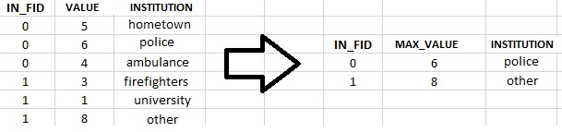
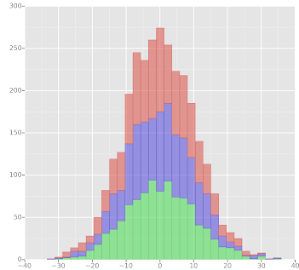
Outline
Univariate Data Visualization
Variable Types
Summary Statistics
Variable
Categorical
Continuous

Slide 3
What is Univariate Analysis?
Univariate analysis
An analysis involving a single variable
Uni = “One”
Bivariate analysis
Analysis involving two variables
Multivariate analysis
Analysis involving many variables
Each can provide different types of information!

Slide 4
Variable Types
Why?
Variable type determines what can be done to that data
Will alter the type of analysis done
Two Types for this Module
Categorical
Continuous

Slide 5
Categorical Variables
Variables that contain a limited group of categories
Gender
Male/Female
Cancer Staging
Stage I/II/III/IV

Slide 6
Continuous Variables
These are numeric variables. They can have potentially an infinite number of possible values between two pre-specified values.
Age
Any number between 0 – 125
Weight
Any number between 0 – 600
Note: Upper and lower limits are arbitrary. In this case, limits are based on what is considered to be realistically possible.

Slide 7
Question 1
In our dataset out primary outcome is whether a patient died or not in the first 24 hours. This outcome is represented in the variable “hospital_death”. Is this variable a continuous or categorical variable?
It is a categorical variable
In our dataset, we have information about how old each patient is. This outcome is represented in the variable “age”. It this variable a continuous or categorical variable?
It is a continuous variable

Slide 8
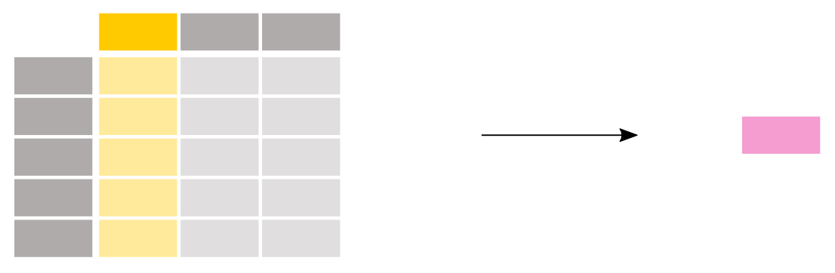
Summary Statistics
Information that generally describes your data. Summary statistics will summarize your observations.

Slide 9
Continuous Variable Summary Statistics
Median: the point on a scale that separated a distribution of scores into two groups; one half of the data are above the median and the other half are below the median
Mean: the arithmetic mean; or the sum of the scores divided by the number of scores

Slide 10
Continuous Variable Summary Statistics (cont…)
Example: 1, 2, 2, 3, 4, 7, 9
Median
{1, 2, 3, 4, 5, 6, 7, 8, 9
(4+5) / 2 = 4.5
Mean
(1+2+2+3+4+7+9)/7 = 4

Slide 11
Continuous Variable Summary Statistics (cont…)
Outliers!
Data that differs significantly from others observations
Can be extremely high or extremely low
Example: 1, 2, 2, 3, 4, 7, 900
Median: 4.5
Mean: 131.3
Median better for data that is skewed or has many outliers

Slide 12
Categorical Variable Summary Statistics
Frequency
The number of observations
Percent
The percentage of that particular category for a variable
Insert table of the hospital death variable

Slide 13
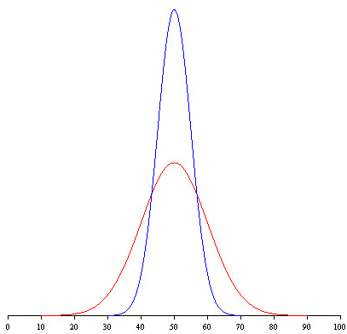
Variability

Slide 14
Variability
Variability show how “spread out” a continuous variable is
Standard deviation: variability measure for means
Interquartile Range (IQR): variability measure for medians
Range: the difference between the largest score and the smallest score.
Notes:
Measures of variability address the question, “How spread out are the scores from one another?”

Slide 15
Question 2
Come up with relevant example data
Ask them to calculate summary statistics from it

Slide 16
Histogram
Data visualization for continuous variables
Graphical display of data using bars of different heights.
Each bar groups numbers into ranges.
Taller bars show that more data falls in that range.
Smaller bars show that less data falls into that range
A histogram displays the shape and spread of continuous data.

Slide 17
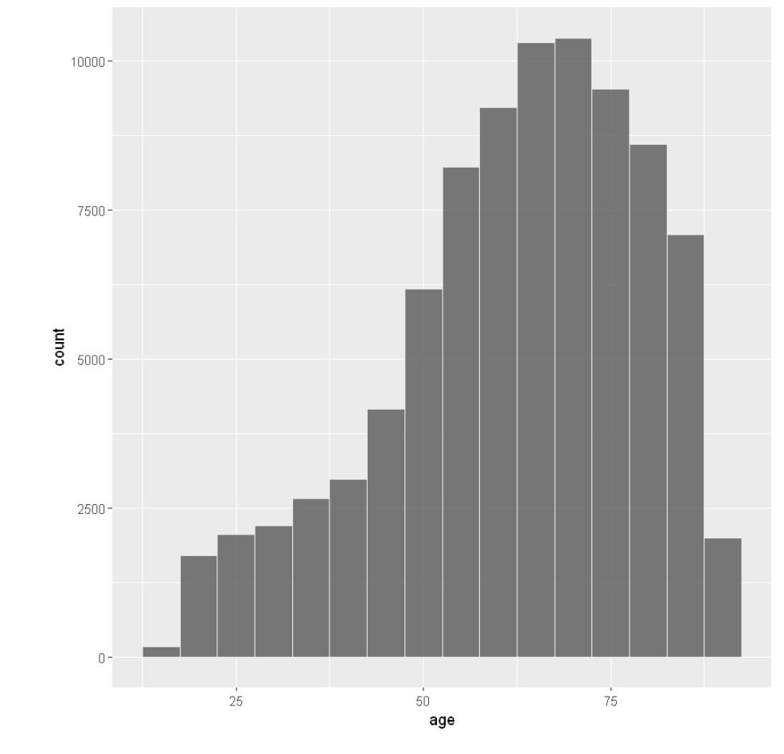
Histogram Example

Slide 18
Bar Plot
Data visualization for graphical variables
Each bar represents a category
Taller bars show that more data falls in that category
Smaller bars show that less data falls into that category

Slide 19
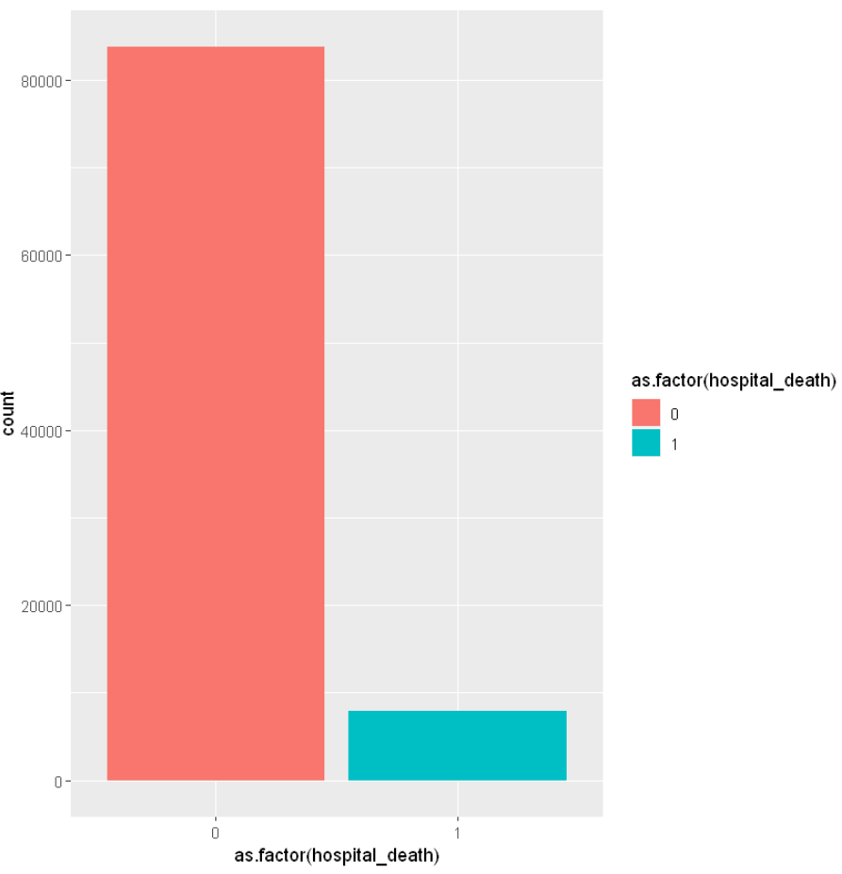
Bar Plot Example

